Slide 1
The Battle of Neighborhoods - Coursera Capstone Project
Finding an optimized method for delivering fresh produce in the nearby restaurants/cafe in North York, Toronto
IBM Course 9 – Applied Capstone Project
By: Shaifali

Slide 2
Problem Formulation
A farmer wants to expand its business in the local neighborhood and wants to deliver fresh produce everyday in the local areas of North York, Toronto. There should be timely delivery of fresh produce, veggies, bread, coffee etc. in order to successfully run the business. In order to achieve that, there should be some optimal method to deliver in every single restaurant/coffee shops/cafe nearby with no delay at all to any place. There are 10 delivery trucks available to use and all the areas to be covered. The best way would be to divide the potential merchants into segment based on their locations and address the mechanism separately for each segment of merchants. This would allow the farmer to use all the resources in a efficient manner and hence help rum a successful business plan.

Slide 3
Python Packages and Dependencies
Pandas - Data Analysis Library
NumPy – Library to handle data as a DataFrame
JSON – Library to handle JSON files
Geopy – Used to find geospatial coordinates
Requests – Library to handle https requests
Matplotlib – Used to generate plots in python
Sklearn – Library to implement Machine Learning techniques
Folium – Map rendering library

Slide 4
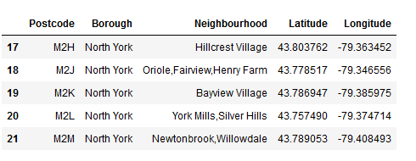
Sample of Data for the neighborhood North York, Toronto

Slide 5
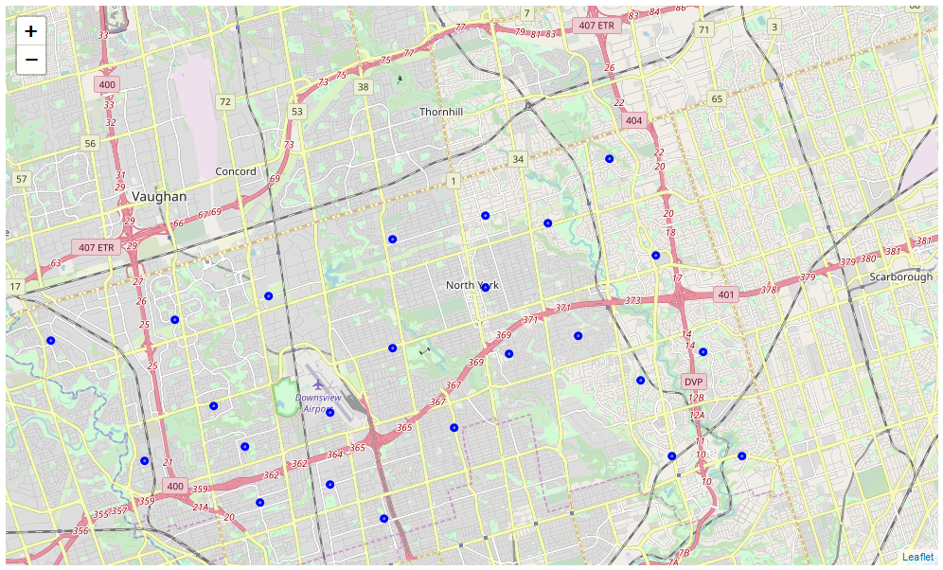
Neighborhood Distribution

Slide 6
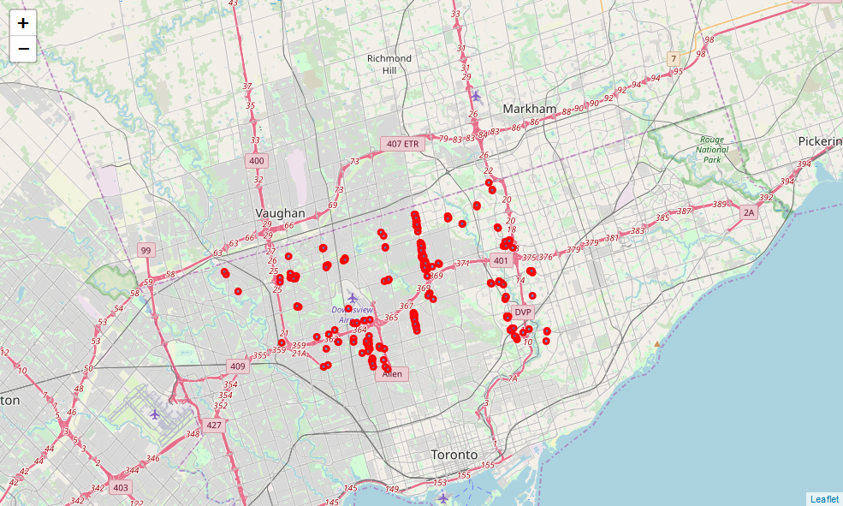
Venue Distribution

Slide 7
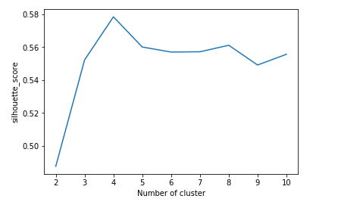
Results – based on K value and Silhouette Coefficient

Slide 8
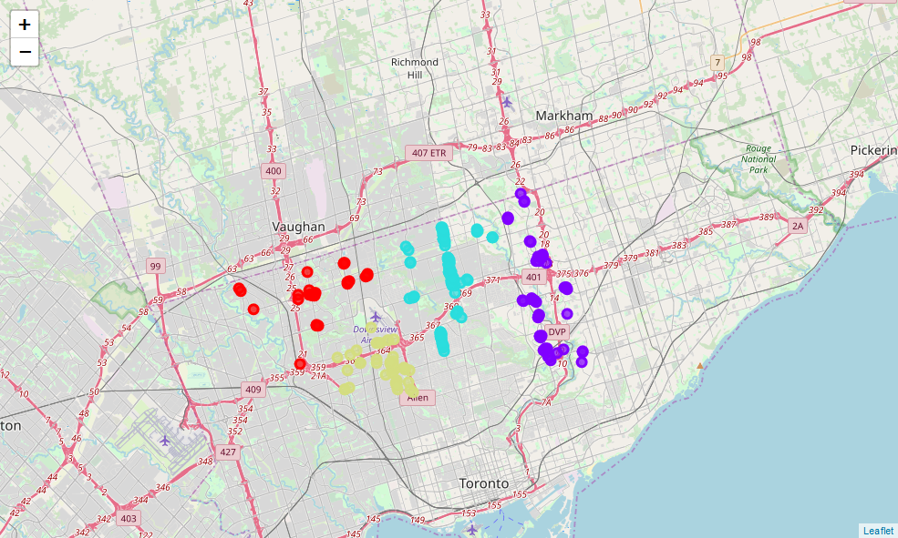
K-means Clustering (K = 4)

Slide 9
Discussion and Conclusion
The techniques and analysis used in the project shows that the optimal way for the farmer to use the delivery trucks in order to cover every interested venue and deliver the produce efficiently can be performed using the clustering method. The efficient number of clusters lies between K = 4 to K = 6. Here, we have suggested K = 4 as the cluster number in order to perform the task in an optimal way which means there will be 4 delivery trucks in total to be used for delivery.

